Slide 1
Access management system for a parking lot using image processing techniques
Intern: PATRASC George Daniel Mentors: VERZEA Ionut
SULIMAN Caius

Slide 2
CONTENTS
TOPIC OVERVIEW
USED TEHNOLOGIES
DETECTION AND RECOGNITION
MAIN FUNCTIONALITIES
DEMO

Slide 3

This topic was chosen with the desire to develop an efficient solution for managing vehicle access in a parking lot, utilizing various educational scientific resources.

Slide 4








USED TEHNOLOGIES
C++ Language
OpenCV
Tesseract OCR
Qt
SQLite
CMake
HTML, CSS, JavaScript
Git

Slide 5
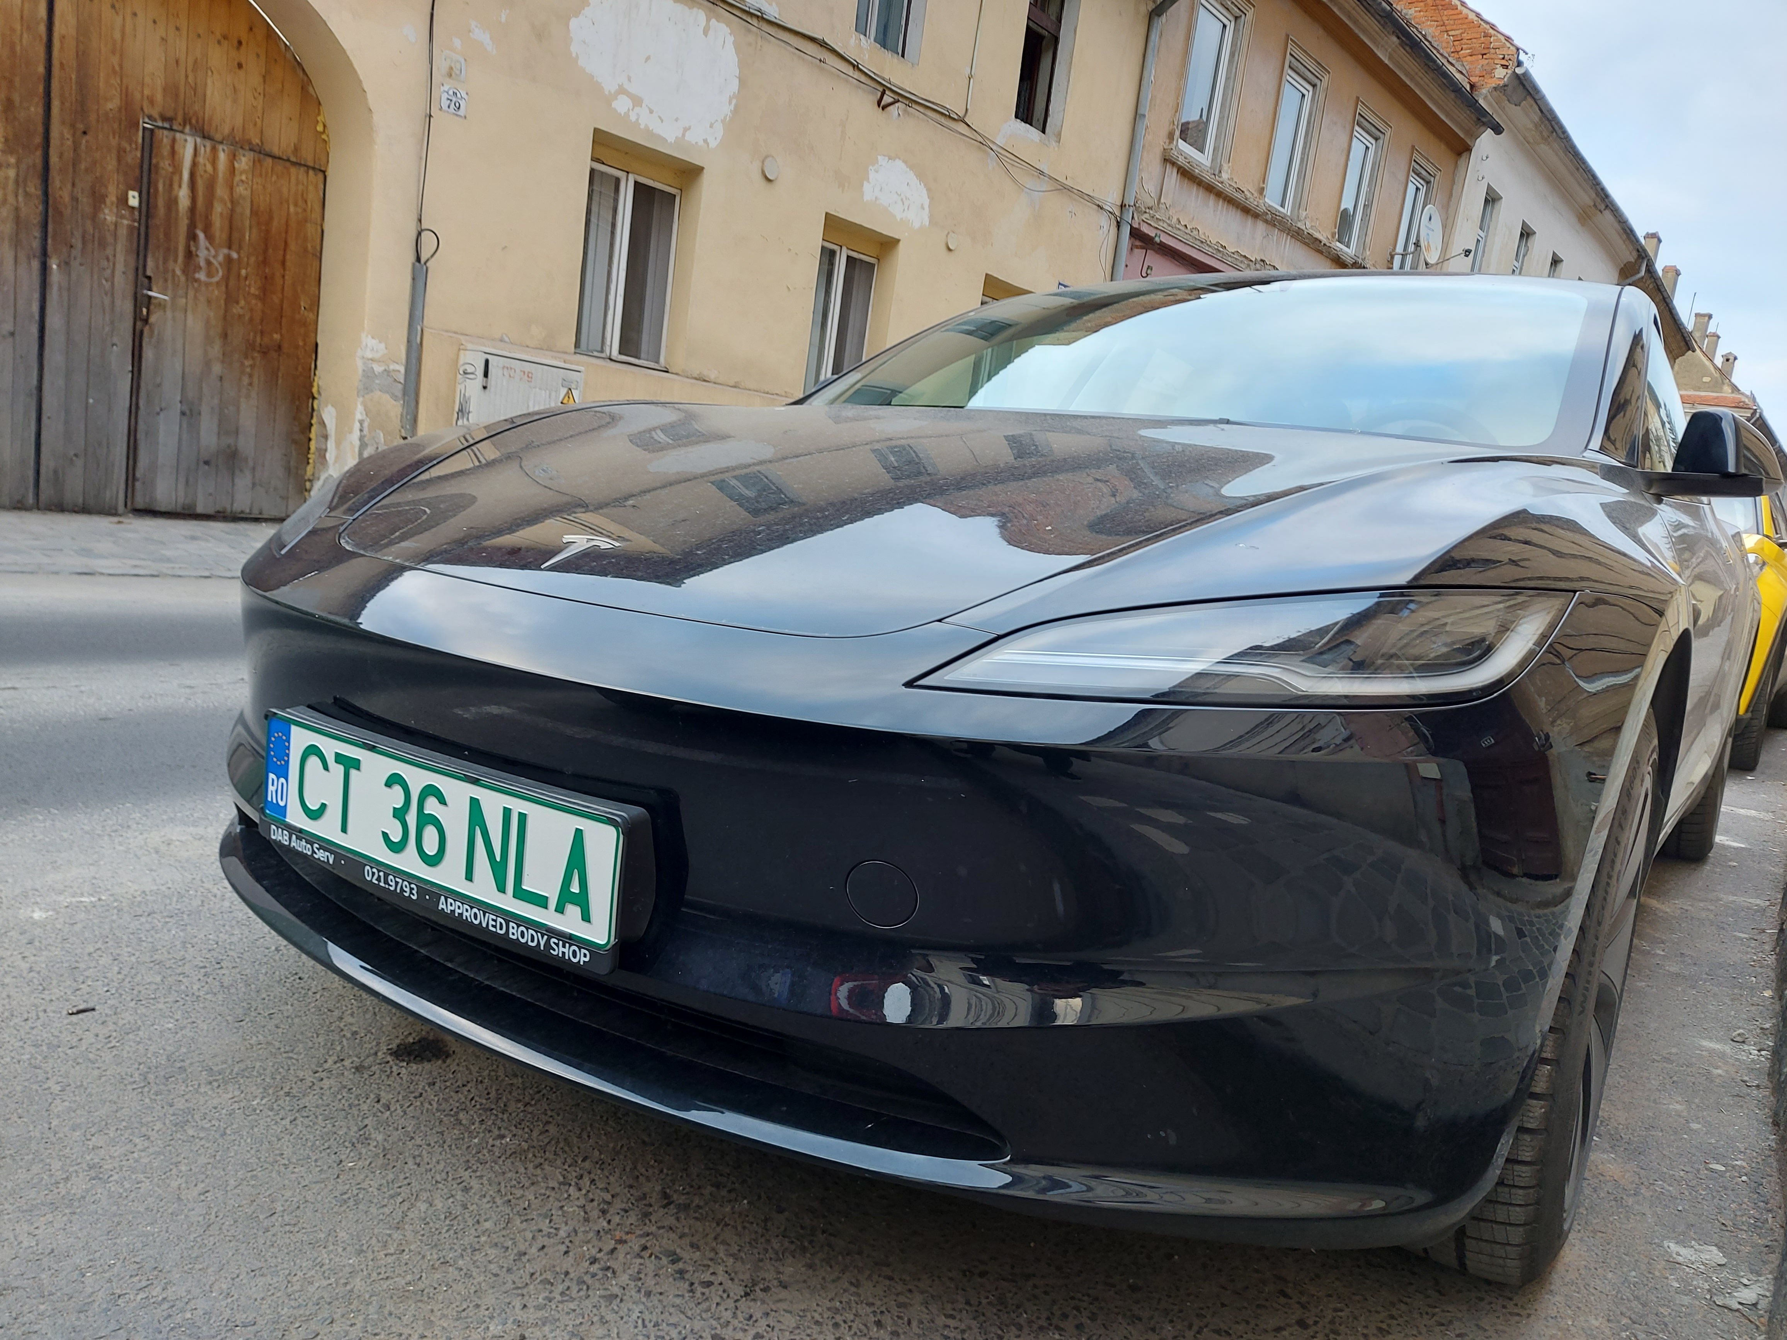
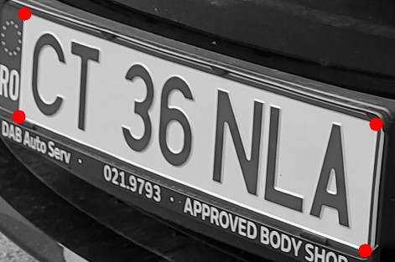


DETECTION AND RECOGNITION
3. Rectification
1. Input
2. Segmentation
CT 36 NLA
4. Input Tesseract OCR
5. Output

Slide 6
MAIN FUNCTIONALITIES
The main functionalities of the application include:
License plate detection
A website for paying parking fees and creating subscriptions
A ticketing system
Statistics on vehicle flow by hour

Slide 7
DEMO
Intern: PATRASC George Daniel Mentors: VERZEA Ionut
SULIMAN Caius

